Slide 1

Chapter 3
Iteration

Slide 2
Content
Control structures - iteration
While
Examples while
For with range
Examples for
Notes:
In this chapter we first define the concept of iteration. Python gives you two possibilities to write a repetition, one is the while structure and the other one is the for structure. Both are discussed using examples.

Slide 3
Control structures
Each program is a combination of statements to be performed in
Sequential mode
Conditional mode
statement
statement
statement
True
statement
condition
statement
False
statement
Notes:
Let's summarize. In chapter 1, you wrote a program in which all statements were executed in a sequential mode one afte the other. In chapter 2 it became clear that depending on a condition the program can be sent 2 ways. Either the statements in the True or the statements in False block are performed but definely not both.

Slide 4
Control structures
Each program is a combination of statements to be performed in
Repetitive mode (iteration, loop, repetition)
Statements can be grouped for reuse in logical blocks called
Functions (methods)
condition
statement
Notes:
In this chapter we ensure that when a line code has to be executed 5 times we do not need to copy the line 5 times and then execute these lines sequentially, but we write the statement once and then determine depending on a condition whether or not the line should be repeated. This control structure makes your code more efficient and allows you to reduce the number of lines to be written. Imagine having to copy the same line 100 times instead of 5 times. Another way to make your code more organised is by grouping statements in functions which you can reuse in your programs. This will be the topic of chapter 6.

Slide 5
While
Syntax:
while condition:
statements
Procedure:
Evaluate the condition: result is True or False
If condition is false
leave the while loop
proceed to execute next statement
If condition is true
execute every statement of the body
go back to step 1
condition
False
True
body
Notes:
One of the ways to code a repetition is the while structure. The syntax starts with the keyword while followed by the condition to be checked ending with a colon. Then, indented the statements to be repeated, the so called body ot the while, follow. Each time the statements are run through, the condition in the while is tested again. From the moment of this condition tests False, the program continues with the statements after the while.

Slide 6
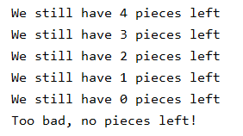
While
Example:
number = 5 while number > 0: number -= 1 print('We still have', number, 'pieces left') print('Too bad, no pieces left!')
Notes:
An example will make everything clearer.
We start with a variable number that gets the value 5. As long as this variable is greater than zero, we reduce it by 1 and print the text.
As soon as the condition is no longer met, we print the last line.

Slide 7
Infinite loop
Pay attention! In the body of the iteration, the value of one or more variables checked in the condition-block must change so that the condition eventually becomes False. Otherwise the loop can never be terminated.
condition
False
True
body
Notes:
A common problem when encoding iterations is that the condition always remains true. In that case, the program can never get out of the loop. It is therefore extremely important that the variables that are tested in the condition change during iteration. Suppose in the previous example that in the loop you don't subtract 1 but add 1 to the number tested in the condition then that number never becomes zero, so the condition stays true for even which means that you have written an infinite loop.

Slide 8
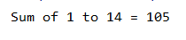
Examples while
Add numbers (from 1 to ... ) as long as the total is less than 100
number = total = 0 #initialization is necessary! while total < 100: number += 1 total += number print('Sum of 1 to', number, '=', total)
Notes:
In this example, all numbers from 1 to ... are added up until their sum exceeds 100.
We initialize 2 variables number and total with the value 0.
The condition in the while checks whether the variable total remains smaller than 100, as long as this is the case, number is increased by 1 and the current number is added to the total. As soon as total is more than 100, the final total is printed.

Slide 9
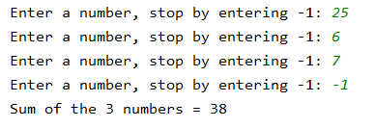
Examples while
Read and sum up numbers as long as you don’t read -1.
Print the number of numbers entered and their total.
total = count = 0 #read the first number before the while number = int(input('Enter a number, stop by entering -1: ')) while number != -1: count += 1 total += number #read the next number number = int(input('Enter a number, stop by entering -1: ')) print('Sum of the', count, 'numbers =', total)
Notes:
In this example, the user can decide how many numbers he wants to enter. When the user wants to end the input he will enter the number -1. So -1 is the stop condition for the loop. The goal of the program is to add all the numbers the user enters, but of course the stop value -1 cannot be part of the final total. To set up this loop you can use the following structure.Step 1: Ask the user to enter a number.Step 2: Check if this number is -1 in the while condition Step 3 .If the number is -1 you go out of the loop, if the number is different from -1 the number is added to the total. Step 4: As the last statement in the loop, ask the user to enter a new number. This number can then be checked in the condition of the while.

Slide 10
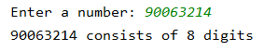
Examples while
Determine the number of digits in a number
You can also write: number //= 10
number = int(input('Enter a number: ')) counter_digits = 0 #we must be able to remember the original number original_number = number while number > 0: counter_digits += 1 number = number // 10 print(original_number, 'consists of', counter_digits, 'digits')
Notes:
In the next piece of code, the number of digits that make up a number is calculated.
For example the number 321 consists of 3 digits. A well-known way to compute the number of digits in a number makes use of the so called floor division. When you use the floor division to divide 321 by 10 the result is 32 When you floor divide this result 32 by 10 you have 3 left and finally the floor division of 3 by 10 ends up with 0. So as long as the result of the floor division of the remaining number differs from 0 there are digits to count.

Slide 11
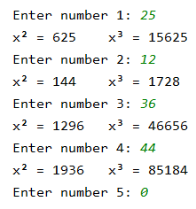
Examples while
Print the square and the third power of a number. Repeat this and stop by entering 0.
counter = 1 number = int(input('Enter number ' + str(counter) + ': ')) while number > 0: print("x² = " + str(number ** 2), "x³ = " + str(number ** 3), sep='\t') counter += 1 number = int(input('Enter number ' + str(counter) + ': '))
Tab character
Notes:
In the following exercise, the second and third powers are calculated from a number different from 0.
Outside the loop the user enters a number. The while condition checks if the number is different from 0. In that case the powers are calculated and printed. As last statement in the loop the user must enter the next number.
When the number 0 is entered the program stops.
Please notice the 3thd argument of the print function. By default the print function adds a space after each element to be printed. This default chararacter however can be changed by explicitly setting the sep parameter. In this example a tab character is printed between the 2 parts.

Slide 12
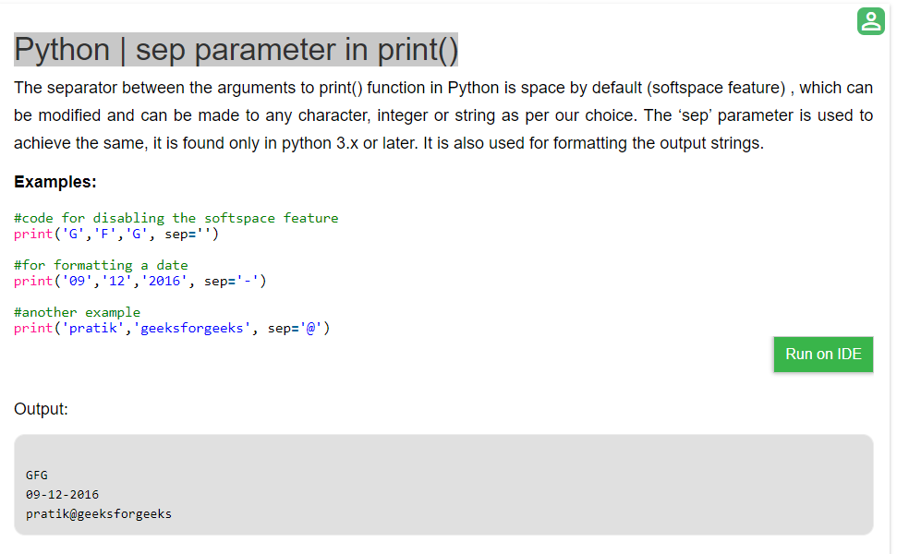
sep parameter in print()
https://www.geeksforgeeks.org/python-sep-parameter-print/

Slide 13
While versus for
If you use a while
there is always a condition that determines whether the component is repeated or not
you often don't know in advance how many times the component will be repeated
You can also use a for loop when:
the number of iterations is fixed in advance
you work with a range of numbers
Notes:
Up till now we only used the while syntax to code a repetition. In a while loop, you re-evaluate each run condition and based on the condition giving True or False the loop is executed again or not. So you often don't know in advance how many times the loop will be repeated
in a for loop on the contrary, you specify explicitly a counter to keep track of the times the loop shall be executed. There is no condition to check. The program will run the loop X times - no more, no less. So the number of iterations is completely fixed.

Slide 14
For loop with range
range(y) all numbers from 0 to y but y not included
range(x, y) all numbers from the starting number x to the ending number y (y not included)
range(x, y, s) all numbers from x to y with step size s, i.e. the distance between the generated numbers. Default step size is 1.
Examples
range(7) 0, 1, 2, 3, 4, 5, 6
range(4, 11) 4, 5, 6, 7, 8, 9, 10
range(4, 11, 2) 4, 6, 8, 10
range(5, 0, -1) 5, 4, 3, 2, 1
Notes:
To define the number of times the for loop will be executed, you use the range funtion.
The range() function generates a sequence of numbers starting from 0 by default , and incrementing by 1. Range (7) generates a sequence of 7 numbers and thus results in the numbers from 0 to 6. If needed you can specify with an extra parameter the starting number. Range (4,11) means that the geberated sqeunce start at 4 instead of 0. and runs up unitil 10.
Last but not least you can also change the step value.

Slide 15
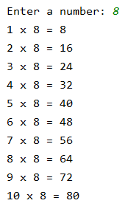
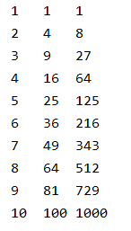
Examples for loop with range
Printing table of multiplication
Powers of 1 to 10
number = int(input('Enter a number: ')) for counter in range(1, 11): print(counter, 'x', number, '=', counter * number)
for counter in range(1, 11): print(counter, counter ** 2, counter ** 3, sep='\t')
Notes:
In the following example we show how to print a multiplication table. In this case we know exactly how often we have to go through the loop. Namely 10 times.
Take a look at the syntax of the for loop. For … The couter successively gets the values of the figures generated by the range function, so the counter changes from one to 10. The variable counter is called an iterator that passes through the Loop In the second example, the second and third powers of all numbers from 1 to 10 are printed.

Slide 16
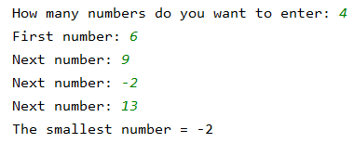
Examples for loop with range
Determine the smallest of a set of numbers
If you have to determine the smallest or largest, always take the first number as the starting value!
count_numbers = int(input('How many numbers do you want to enter: ')) smallest = int(input('First number: ‘))
for i in range(count_numbers - 1): number = int(input('Next number: ')) if number < smallest: smallest = number print('The smallest number =', smallest)
Notes:
In this exercise you have to find the smallest number in a series of numbers. The program starts with the question of how many digits the end user wants to enter. This number is the upper limit of the Range function . When you notice minus 1, this is because the first number is already entered befor the loop starts. You automatically consider this first number as the smallest number. Each iteration you enter a new number and you check whether this number is smaller than the smallest number. After the loop you know exactly wich number enterd is the smallest.

Slide 17
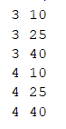
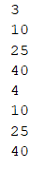
Nested for loops with range
for x in range(3, 5): for y in range(10, 50, 15): print(x, y)
for x in range(3, 5): print(x) for y in range(10, 50, 15): print(y)
Notes:
Let's take a look at more difficult examples in which so called nested for loops are used.
In this examples hhe program first encounters the outer loop, executing its first iteration. This first iteration triggers the inner, nested loop, which then runs to completion
In the first example, the iterator x in the outer loop starts at value 3. In the inner loop , an iterator y starts at 10 and loops with a stepvaluz of 15 unitl 40. when the iner loop is compleyef thev outer loop takes over and theiteror x gets its next valiue 4. then the innerloop starys again movig the y ierator from 10 to 25 to 40. the second example is almost identical. The differce is that the value of the iterator is printed in itsown loop. So x printed in the outer loop y printe in yhe inner loop

Slide 18
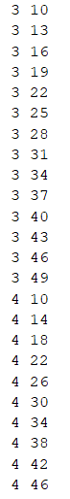
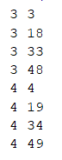
Nested for loops with range
for x in range(3, 5): for y in range(x, 50, 15): print(x, y)
for x in range(3, 5): for y in range(10, 50, x): print(x, y)
Notes:
In the next piece of code, the value of the X iterator is used as the starting value for the iterator in the inner loop.
and in the last example the value of x becomes the step value of the inner loop.

Slide 19
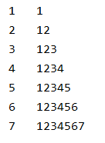
Nested for loops with range
We want to print:
for i in range(1, 8): print(i, '\t', end='') # print i + TAB and don't go to a new line for j in range(1, i + 1): print(str(j), end='') # print j and don't go to a new line print() # go to a new line
Notes:
So take a look at the desired output
To obtain this result , the outer loop iterates from 1 til 7 and each run the iterator is printed , followed by a tab character. After the print the cursor doesn’t move on to the next line. This is done by setting the end parameter of the print function to an emty string.
Then the inner loop starts and uses the the value of the ourter loop(s itrair i as its stop value. Each value of y is printed on the same line when the inner loop is completed whe put the cursorto the next line with an empty print-fuction.
Anf finally the outerloop iterr i gets its next value.

Slide 20
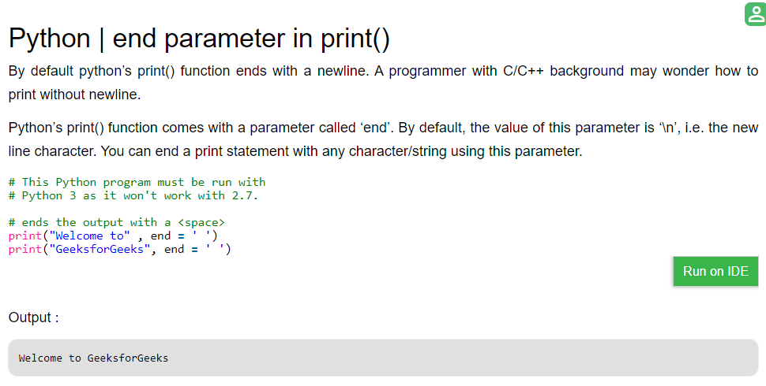
end parameter in print()
https://www.geeksforgeeks.org/gfact-50-python-end-parameter-in-print/Sdq

